Slide 1
COMP 7212: Operating/Distributed Systems
Chapter 2: Architectures
Dr. Myounggyu Won
Reference: Distributed Systems: Principles and Paradigms (3rd Edition)

Slide 2
Outline
Architectural styles (logical organization/software architecture)
  Layered architectures
  Object-based and service-oriented architectures
  Resource-based architectures
  Publish-subscribe architectures
Middleware organization (various techniques to adjust the middleware to meet the needs of applications)
  Wrappers
  Interceptors
System architecture (physical organization/hardware architecture)
  Centralized organizations (server and client)
  Decentralized organizations (peer-to-peer systems)
  Hybrid architecture (centralized + decentralized)

Slide 3
Architectural Styles

Slide 4
Basics
Component: a modular unit with well-defined interfaces.
  e.g., nodes, processes, hardware resources, etc.
Connector: a mechanism for communication and coordination among components
  e.g., remote procedure calls (RPC), message passing.
Using components and connectors, various configurations can be created, which is called architectural styles
  Layered architectures
  Object-oriented architectures
  Resource-centered architectures
  Event-based architectures

Slide 5
Layered Architectures (1/4)
Basic idea: components are organized in a layered fashion
  A component at a layer can make a down call to the component at a lower layer (and generally expects a response).
  An up call is made in only exceptional cases.
    Increase the complexity of the system, leading to higher burden and potentially more bugs
    Performance degradation; upper layers might not be optimized for frequent interruptions from lower layers
    Up calls are typically used in exceptional circumstances where an event or error detected at a lower layer must be communicated immediately to higher layers.

Slide 6
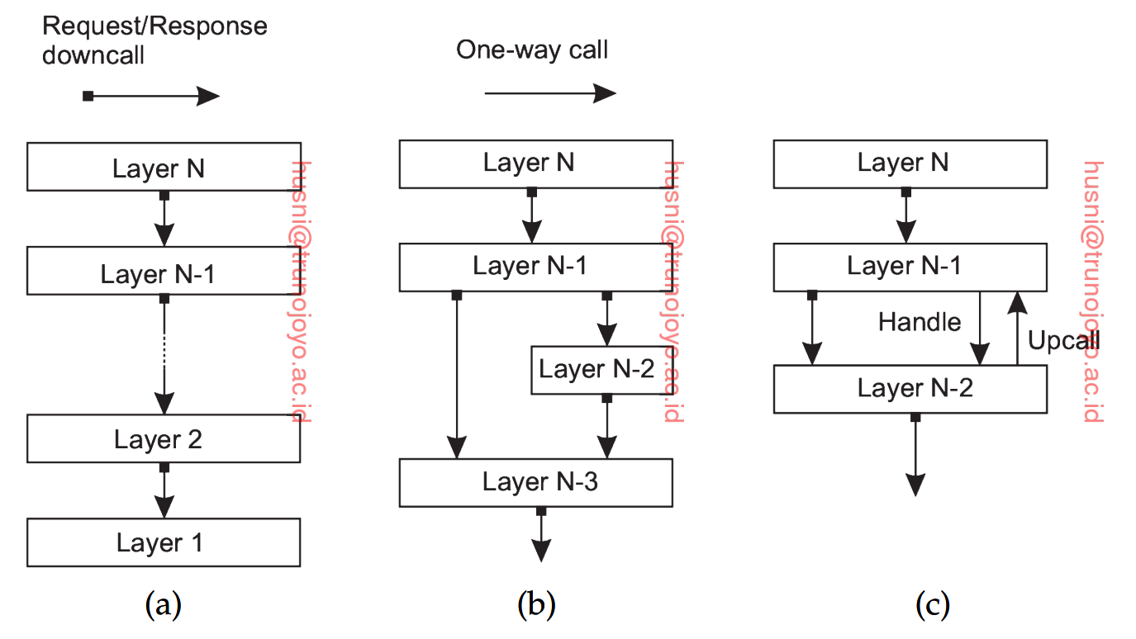
Layered Architectures (2/4)
Three common layered architectures:
Up call only at an
exceptional case, e.g.,
when an error happens
Standard organization with
only down calls
Available to both upper layers

Slide 7
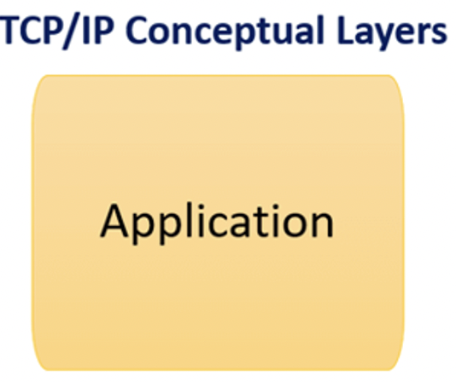
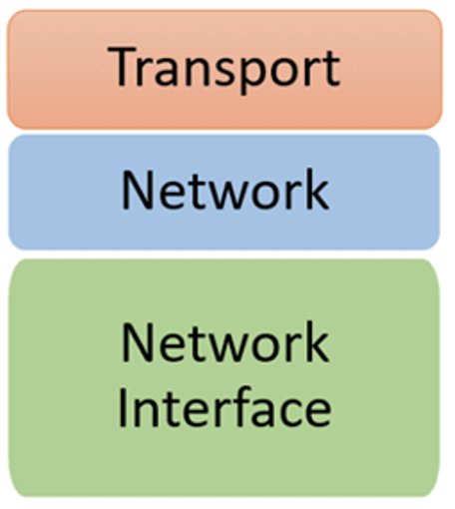
Layered Architectures (3/4)
A well-known layered architecture is that of communication protocol stacks.
  Each layer implements one or more communication services
  Each layer offers an interface specifying the functions (of that layer) that can be called
    The interface hides the actual implementation of service.
  e.g., transmission control protocol (TCP)

Slide 8
Layered Architectures (4/4)
Application layering (the application layer can be further divided into sub-layers)
  The application interface level
    Handles interaction with the user or other applications
  The processing level
    Performs main operations
  The data level
    Represents data for the application
Example: Internet search engine
  Interface: user types in a keyword and is presented with a list of web pages
  Processing: transforms a keyword into database queries, ranks the results, transforms the results into a series of HTML pages
  Data: a huge database of web pages

Slide 9
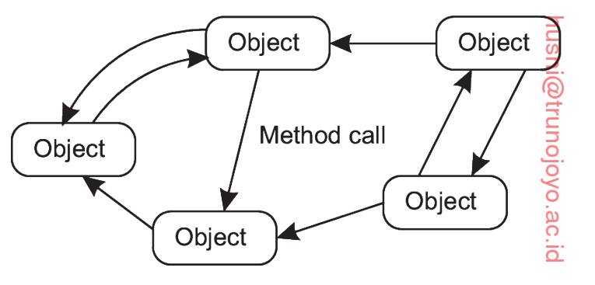
Object-based and Service-oriented Architectures (1/4)
Object-based architecture
  Each object corresponds to a component which is connected through a procedure call mechanism (procedure call can happen remotely).
  Advantage: data and operations are encapsulated into a single entity.
  Only an interface is exposed concealing the details.
    This means that an object can be easily replaced if the interface is untouched.

Slide 10
Object-based and Service-oriented Architectures (2/4)
  This separation between interface and objects allows us to
    Place an interface at one machine, while the object itself resides on another machine (distributed object)
    When a client accesses a distributed object, a proxy (an implementation of the object’s interface) is loaded in the client’s address space.
The proxy acts as an intermediary, allowing clients to interact with the remote object as if it were local to them.
  Abstracts the complexity of network communication
  Hides the location of the remote object the client is communicating with
  Provides an additional security layer
  Performs load balancing regarding client requests to access remote objects

Slide 11
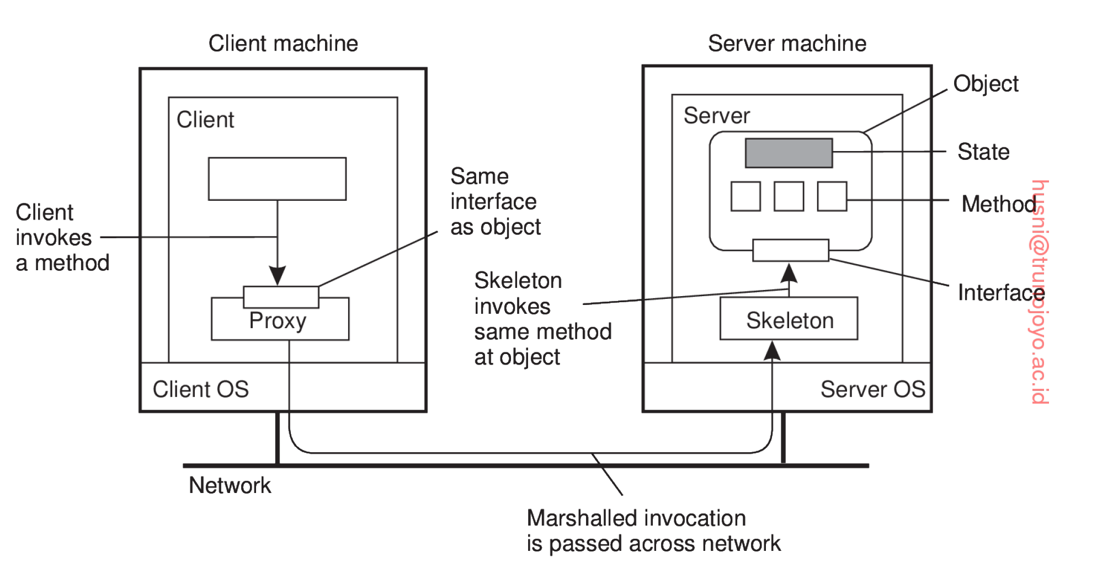
Object-based and Service-oriented Architectures (3/4)

Slide 12
Object-based and Service-oriented Architectures (4/4)
Service-oriented architectures
  A distributed system is essentially a composition of many different services
  Components are organized based on services
  e.g., online shopping platform. Payment processing, receiving orders, etc. are services, and components can be organized based on that

Slide 13
Real-World Examples of Object-based Architectures
Distributed Component Object Model (DCOM)
  A Microsoft technology for software components distributed across several networked computers to communicate with each other.
Java RMI (Remote Method Invocation)
  A Java-specific technology that allows Java objects to invoke methods on Java objects located remotely, supporting the development of distributed Java applications.

Slide 14
Real-World Examples
Amazon S3 (Simple Storage Service)
  S3 uses the concept of objects to store data. Each object in S3 is stored with its metadata and is identified by a unique key, embodying principles of object-based architecture in a distributed environment.

Slide 15
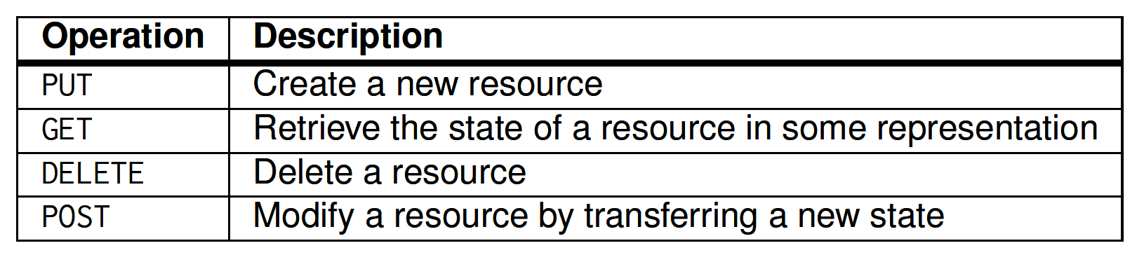
Resource-based Architectures (1/2)
Resource-based architectures
  View a distributed system as a huge collection of resources that are individually managed by components
  Resources can be added, removed, retrieved, or modified
  Widely adopted for the Web and known as RESTful architecture
  Key characteristics of the RESTful architecture
    Resources are identified by a single naming scheme (e.g., URL)
    All services offer the same interface consisting of at most four operations
    Messages sent to/from a service are self-described
      each request or response contains enough information for the receiver to understand what the message is, how to interpret it, and what to do with it.
    Stateless, i.e., after executing an operation at a service, that component forgets everything about the caller

Slide 16
Resource-based Architectures (2/2)
Benefits of RESTful Architecture
  Scalability
    Due to stateless (no need to store) and cacheability (e.g., HTTP responses can be cashed and retrieved later, i.e., fewer requests) properties
  Interoperability
    Use the same interface (operations focused on managing resources)
    e.g., Web is accessible with web browsers, mobile devices, etc.
  Simplicity
    The simple interface
    Messages are self-described
  Flexibility
    Not tied to specific technology or platform.

Slide 17
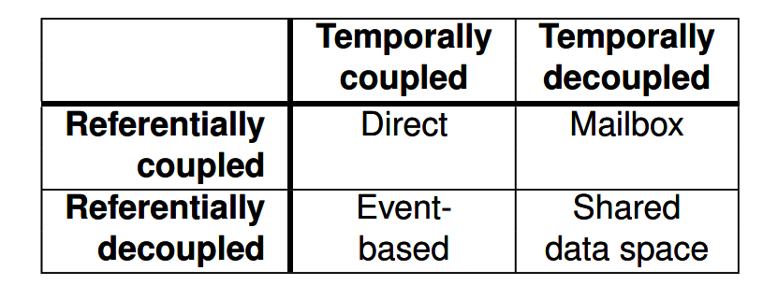
Publish-Subscribe Architectures
Publish-subscribe architectures
  In many systems, processes/components are becoming more autonomous, i.e., easily join or leave the system
  Thus, an architecture in which dependencies between processes/components are as loose as possible is needed
  In particular, Cabri et al. [2000] define four different models for process/component dependency
    Referentially coupled: use naming for communication
      e.g., Direct communication, Mailbox-based communication
    Temporally coupled: processes communicating should be up and running
      e.g., event-based coordination: no name is needed; just publish a notification of an event; subscribers should be up and running
      Shared data space: processes do not need to be up and running; they can read shared data at any time

Slide 18
Middleware Organization
“Let’s zoom into the actual organization of the middleware”.

Slide 19
Middleware
Distributed systems are becoming increasingly complex.
One way to achieve the integration of heterogeneous software and hardware is through the use of middleware.
Middleware is a software component that provides services between two or more heterogeneous components.

Slide 20
Middleware Organization
Two important design patterns applied to organization of middleware to act as an intermediary between heterogeneous components
  Wrappers and interceptors
  A means to extend and adapt the middleware

Slide 21
Wrappers (1/2)
Problem: the interfaces of one component may not be suitable/compatible for another component.
A wrapper (or adaptor) solves the problem of the incompatible interfaces
  A software module that converts one interface to another, and vice versa.
With N components, we would, in theory, need to develop N*(N-1) = O(N²) wrappers to enable each pair of applications communicate with no compatibility issue
  Note that each application needs N-1 wrappers.
A reduction of the number of wrappers is done by using a broker
  broker: component that has all interfaces of components
    Because a broker offers an interface to each component, only need 2N wrappers, i.e., O(N), instead of O(N²)
      i.e., each component maintains a wrapper to communicate with the broker, and the broker maintains a wrapper for each component.

Slide 22
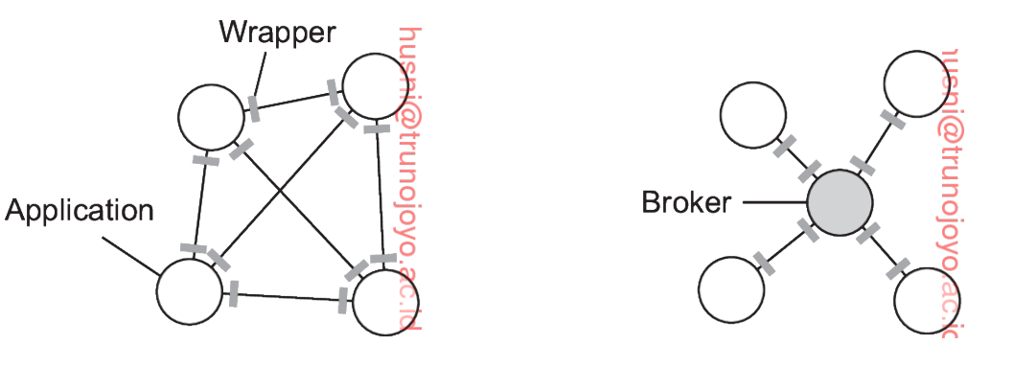
Wrappers (2/2)
Example
A component can communicate with another
component via the broker
O(N²) wrappers
O(N) wrappers

Slide 23
Example Use Case
A distributed application that requires interaction with multiple types of databases.
  A database middleware wrapper
    provides a uniform API to execute queries
    manages connections across different database systems (like MySQL, PostgreSQL, and MongoDB).

Slide 24
Interceptors (1/4)
Problem: Components are highly interconnected, making it difficult to add or modify their functions.
Interceptor
  A mechanism for altering or augmenting the function of a component without modifying its core functionality.
  Allow for the dynamic injection of functions such as logging, security (like authentication and authorization), and error processing.

Slide 25
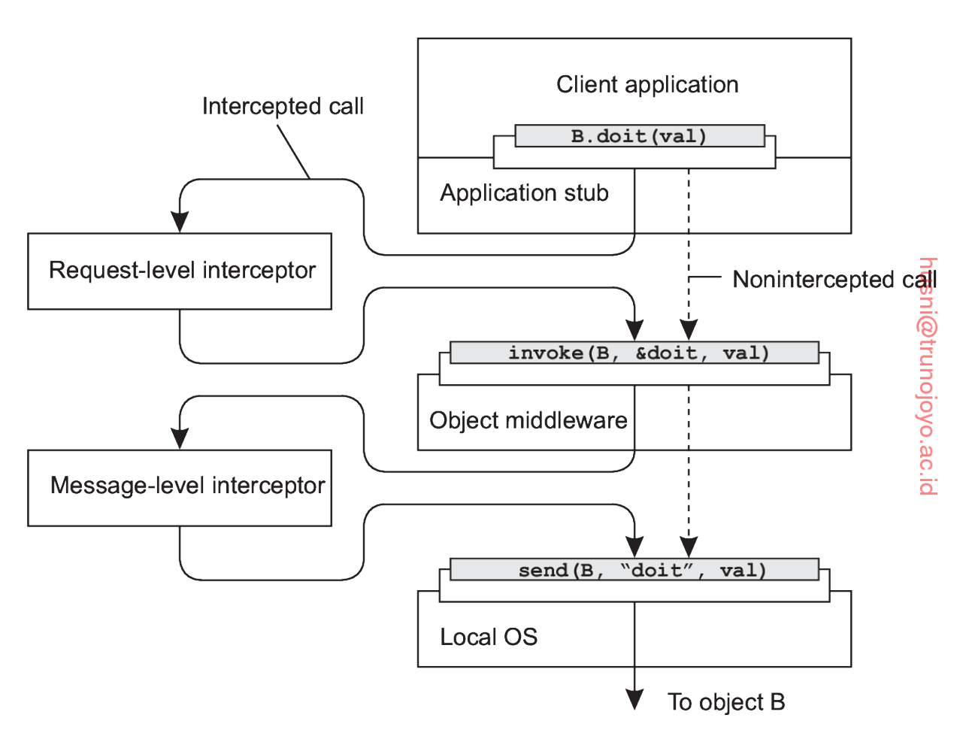
Interceptors (2/4)
“filters” that are placed into the execution path between different middleware layers.
  When a request is made from one component to another, it passes through the interceptor, which can then execute predefined operations before passing the request along to the next component in the chain.
e.g., authentication
e.g., encryption

Slide 26
Interceptors (3/4)
Types of operations performed by interceptors
  Logging
    Recording details about requests and responses.
  Authentication and Authorization
    Checking credentials to ensure that the requester has the right to access the requested resources.
  Data Validation
    Ensuring that incoming data meets the required criteria before it is processed by the application.
  Error Handling
    Catching and managing errors.
  Performance Monitoring
    Collecting data on performance metrics to monitor the health and efficiency of the application.

Slide 27
Interceptors (4/4)
Practical Example
  Consider an e-commerce application that needs to ensure that only authenticated users can place orders.
  An interceptor can be used to check if there is a valid authentication token in the request headers before the request reaches the order processing logic.
  If the token is not valid, the interceptor can block the request and return an error response.
  This keeps the authentication logic separate from the business logic of order processing, making the system more modular and easier to maintain.

Slide 28
System Architecture

Slide 29
Centralized Organizations (1/4)
In this architecture, there is a node (server) that implements a specific service, and other nodes (clients) use the service.
Client-server architecture
  Nodes are divided into two groups (server and client)
  A server implements a specific service (e.g., file system, database system)
  A client is a process that requests a service
  Communication between a server and a client
    Connectionless communication (used in a reliable network, e.g., LAN)
      A client just transmits a request, and a server keeps waiting for a request
      Efficient, but messages can be lost; simple retransmission may not work for some applications
    Connection-oriented communication
      A client first sets up a connection to a server
      A message exchange is done via the established connection
      Once communication is done, the connection is torn down
      More appropriate for a wide-area network which is inherently unreliable

Slide 30
Centralized Organizations (2/4)
Multitiered architectures (a variant of the server-client architecture)
  Recall application layering
    The application interface level
    The processing level
    The data level
  The idea is to distribute these layers across different machines
  allows for greater flexibility, scalability, and maintainability
    Flexibility: each layer can be changed independently.
    Scalability: application tasks can be distributed to multiple machines, reducing the burden.
    Maintainability: Because responsibilities are separated, changes and bugs are easier to isolate.

Slide 31
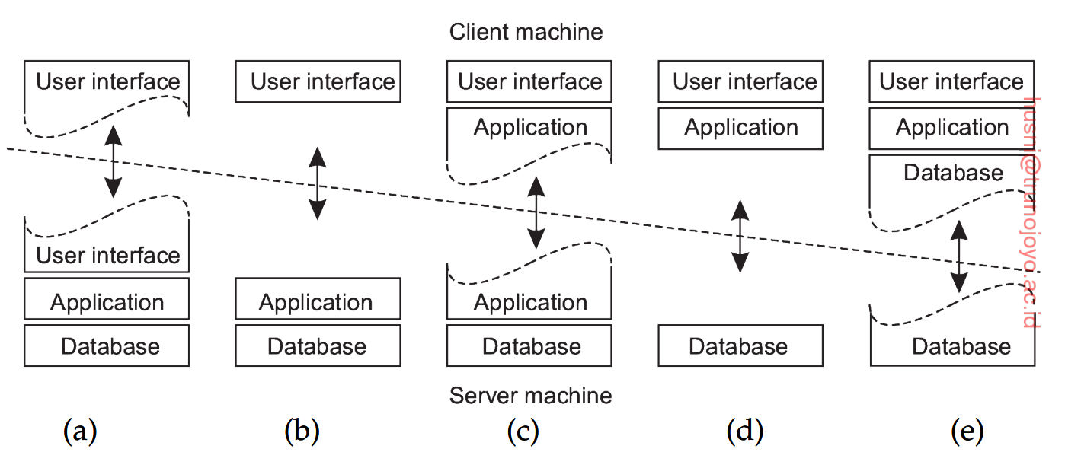
Centralized Organizations (3/4)
Only part of
Interface
(e.g., terminal)
Part of application (processing)
Entire interface
Entire application

Slide 32
Centralized Organizations (4/4)
Real-world example of distributed systems built based on multi-tiered architecture
  E-commerce platforms like Amazon
    The user interface displayed on the user's web browser.
    Server-side scripts that handle the processing of user requests, business rules, transactions, and communications.
    Components that handle data management and storage. This layer communicates with databases to retrieve, update, and manage data.
    The actual databases or storage systems where data like user profiles, product information, and transactions are stored.

Slide 33
Decentralized Organizations: Peer-to-Peer Systems (1/4)
Peer-to-peer systems
  Each node acts as a client and a server at the same time
  Examples
    Filesharing networks (e.g., BitTorrent)
    Cryptocurrencies (e.g., Bitcoin)
    Communication services (e.g., Skype)
    Storage systems (e.g., Storj)
  A question is how to organize the nodes in an overlay network
    Structured P2P systems
    Unstructured P2P systems
    Hierarchically organized P2P networks

Slide 34
Decentralized Organizations: Peer-to-Peer Systems (2/4)
Structured peer-to-peer systems
  Nodes are organized in an overlay that adheres to a specific, deterministic topology (e.g., ring, tree, grid, etc.)
    Used to efficiently look up data.
  One characteristic is that each data item is uniquely associated with a key
  Each node is responsible for storing data associated with a specific subset of keys
  The system provides an efficient mechanism to map a key to an existing node
    Existing node = lookup(key)

Slide 35
Decentralized Organizations: Peer-to-Peer Systems (3/4)
Unstructured peer-to-peer systems
  Each node maintains an ad hoc list of neighbors
    An overlay network is represented as a random graph where an edge between two nodes exists with a certain probability.
  A node changes its list of neighbors continuously
  When a node joins, it contacts a well-known node to obtain a starting list of other peers
  Unlike structured peer-to-peer system, looking up data cannot follow a predetermined route
    Flooding
      A request for a data item is passed to all nodes.
      Very expensive -> a time-to-live (TTL) value is used to specify the maximum number of hops (node-to-node transmission) a request is allowed to be forwarded.
    Random walks
      Send a request to a randomly chosen neighbor -> if there is no data, forward the request to its randomly chosen neighbor, and so on.
      Less network traffic
      But takes longer to find data items

Slide 36
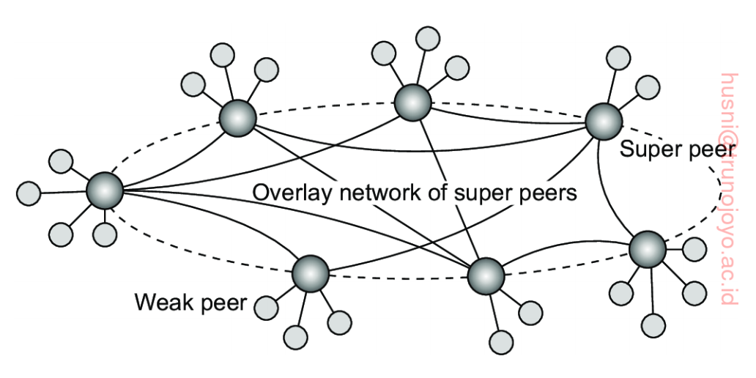
Decentralized Organizations: Peer-to-Peer Systems (4/4)
Hierarchically organized peer-to-peer networks
  In unstructured peer-to-peer systems, locating data can be problematic as the network size grows
  As an alternative, use special nodes (called super peers) that maintain an index of data items
    The leader election problem arises to select super nodes.
Weak peers are connected to a super
peer. All communication from and to
a weak peer proceeds through that
node’s super peer.

Slide 37
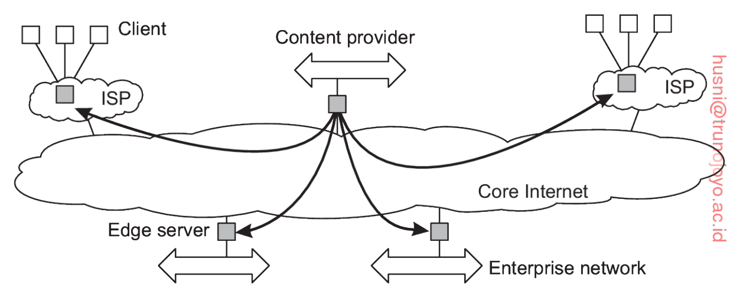

Hybrid Architectures (1/2)
A client-server architecture combined with a peer-to-peer architecture
Edge-server systems
  These systems are deployed on the Internet where servers are placed “at the edge” of the network, i.e., boundary between enterprise networks and the actual Internet
  The servers coordinate like a peer-to-peer system to optimize content distribution

Slide 38
Hybrid Architectures (2/2)
Collaborative distributed systems
  When the system is started, a traditional client-server scheme is used
  Once a node has joined the system, it can use a fully decentralized scheme for collaboration
  e.g., BitTorrent
    To download a file, a user accesses a global directory
    A node is forced to help others by providing chunks of file it is downloading.

